Slide 1

ENTERPRISE SOFTWARE DEVELOPMENT

Slide 2
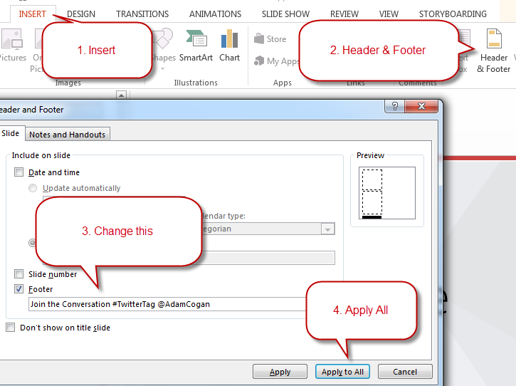
Change the Footer
Make sure you don’t forget the footer. Everyone forgets the footer.
TIP: If your content interferes with the footer you can slide it to one side.

Slide 3
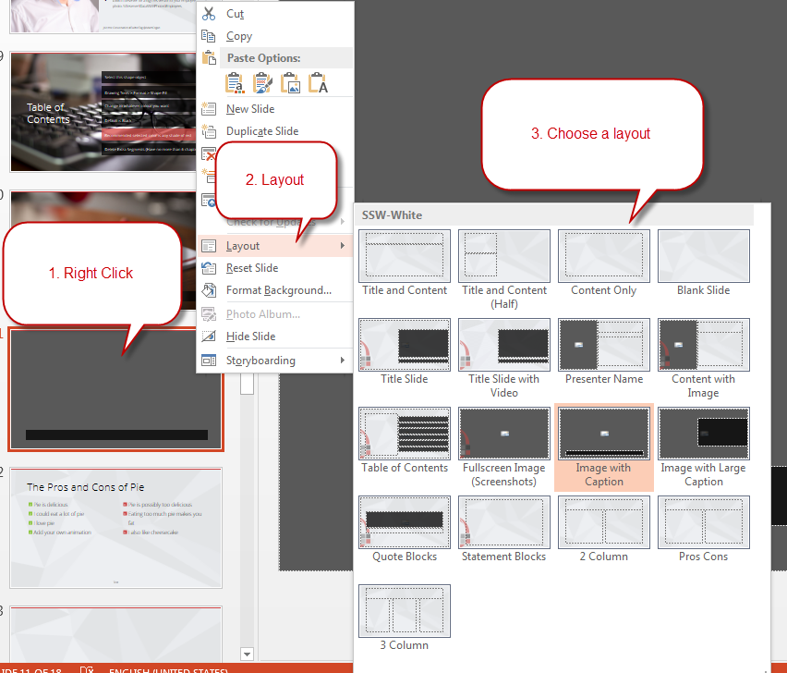
Use Different Slide Layouts
Make sure you’re using the template correctly with slide layouts.

Slide 4
SSW Template
Version 4.0 by SSW Design Tip: Slides have additional info in View | Notes.
Notes:
V4.0 Beautified by Jayden

Slide 5
















Icon Library
These icons are pulled from http://fontawesome.com
Feel free to use your own by pasting in any SVG. You can use PowerPoint to recolor SVGs (Right Click > Fill).

Slide 6




Other Icons
Here are some little red people and other items!
ssw.com.au/rules/do-you-use-standard-question-mark-when-you-are-going-to-ask-the-audience-something
Question Man Demo Man Bad Example Good Example

Slide 7

Adding logo watermark
If you want the logo overlap as shown in the template, you’ll need the logo in the bottom right of this slide. Just copy paste it onto relevant slides.

Slide 8

Vercel - Simplifying Your Development with Zero Configuration
.NET UG - October 2023

Slide 9
Tylah Kapa
SSW Software Engineer
@JadeKapa
https://www.linkedin.com/in/tylah-kapa/
Broke an arm while arm-wrestling
Bad at kickboxing
Collects expensive cardboard

Slide 10
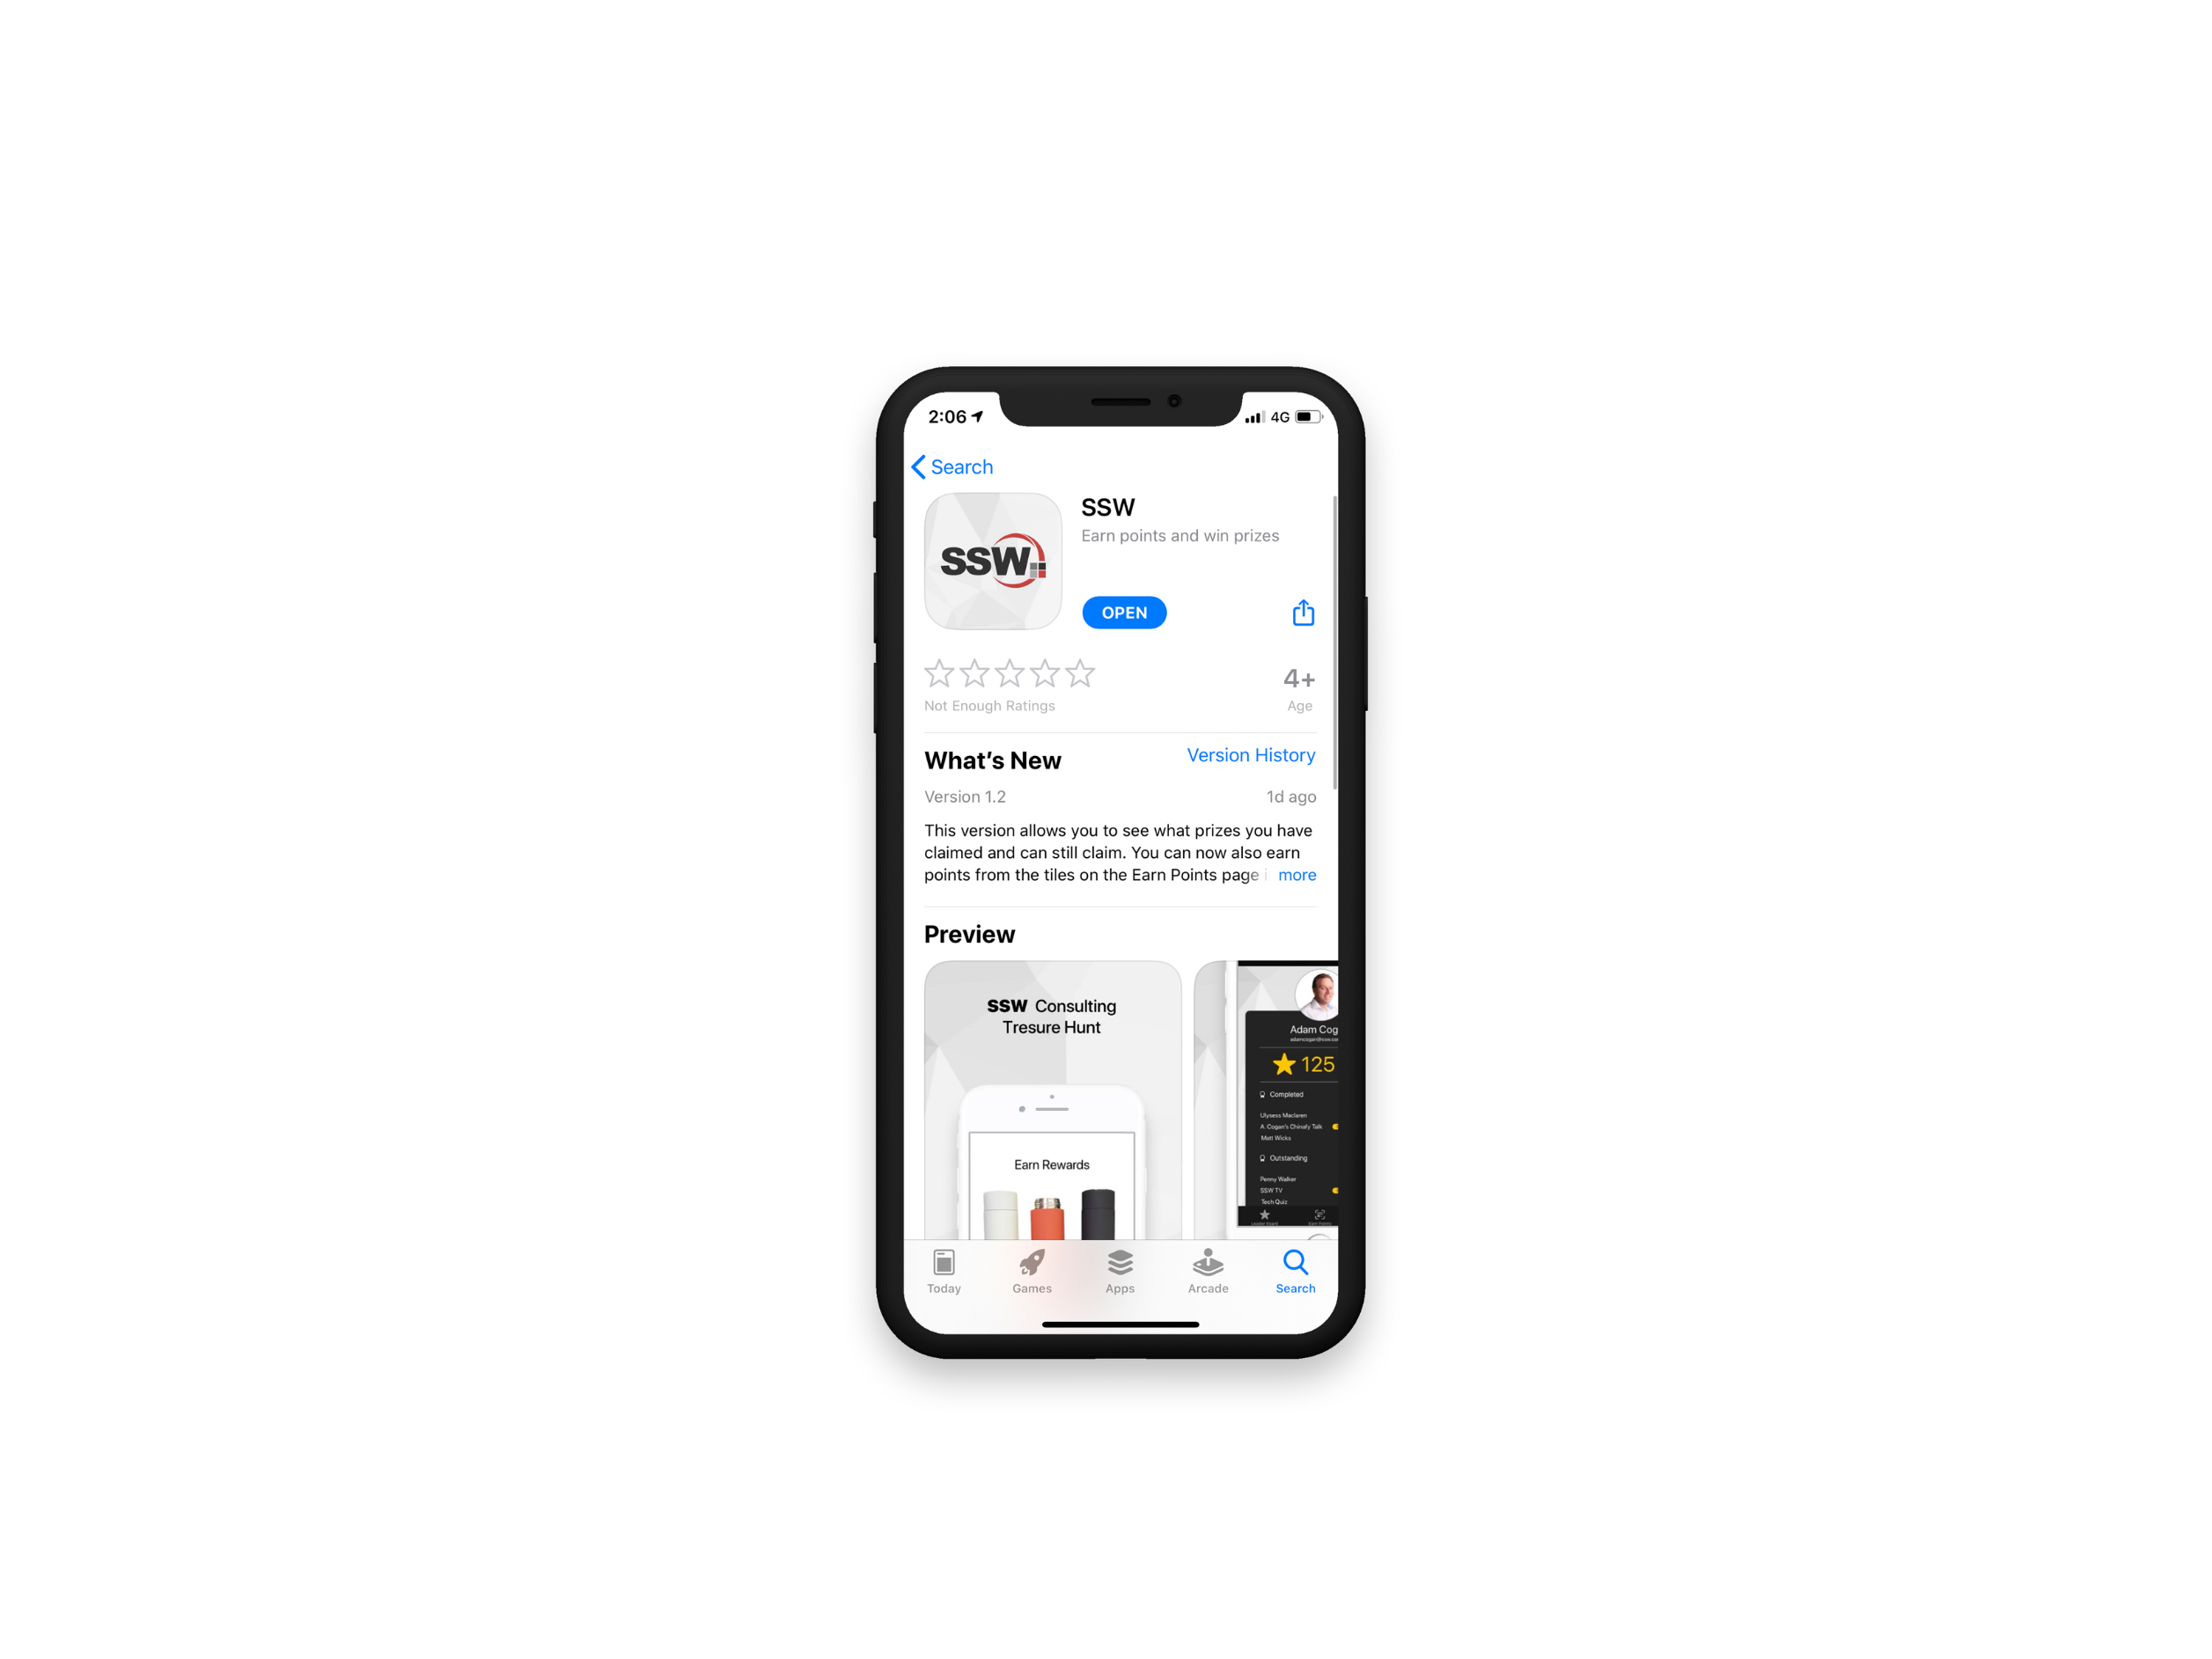

Scan QR Code to install app
Scan SSW codes at talks and events
Earn SSW Points
claim rewards, and win prizes
SSW Rewards
Notes:
An SSW Admin will give you your QR code https://my.sugarlearning.com/SSW/items/13946/ssw-rewards-setup-the-ssw-rewards-app

Slide 11


Agenda
1. What started this journey?
2. What is Vercel and NextJs?
3. Vercel Demo
4. How does Vercel compare?
5. Summary

Slide 12
What started this journey?

Slide 13

Requirements
Blog site
Easy to stand up
Easy to maintain and update
Good analytics
Static Site Generation
$FREE.99
Notes:
Wanted a Blog:
Easy to stand up
Easy to update
No maintenance
FREE

Slide 14

”How would I do that?”
Azure
Create Repo
Create Azure Resources
(Static Web App, App Insights etc.)
Setup GitHub Actions
Debug
Sadness

Slide 15
What is Vercel?
End-to-end platform
Deployments
CI/CD
Analytics
Edge Functions

Slide 16
What is NextJs?
React Framework
Create fast SEO React Apps
SSG, SSR, ISR
Fully integrated with Vercel

Slide 17









and more…

Slide 18
How can you use Vercel?

Slide 19
Where does Vercel Stand?
Scalability
Performance
Edge functionality
Ease of use
Focus on development
Incredible free features
(Mostly) Locked into NodeJs
Front-End focus
Less CI/CD opportunity
Collaboration is Pro only

Slide 20
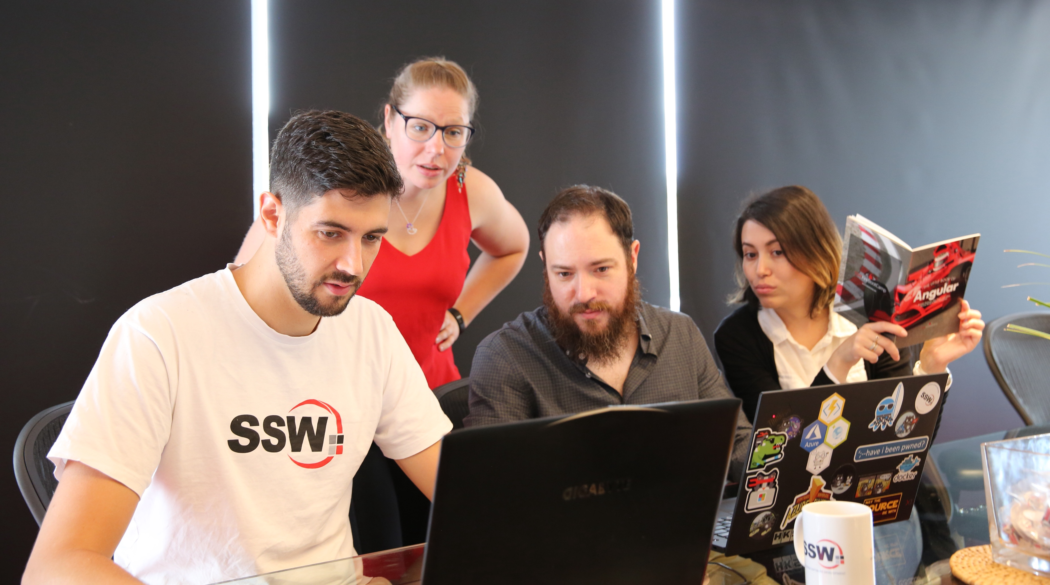
SSW Stock Images – \\fileserver.sydney.ssw.com.au\DataSSW\Photos\Powerpoint-StockImages
Notes:
https://www.ssw.com.au/rules/use-creative-commons-images

Slide 21
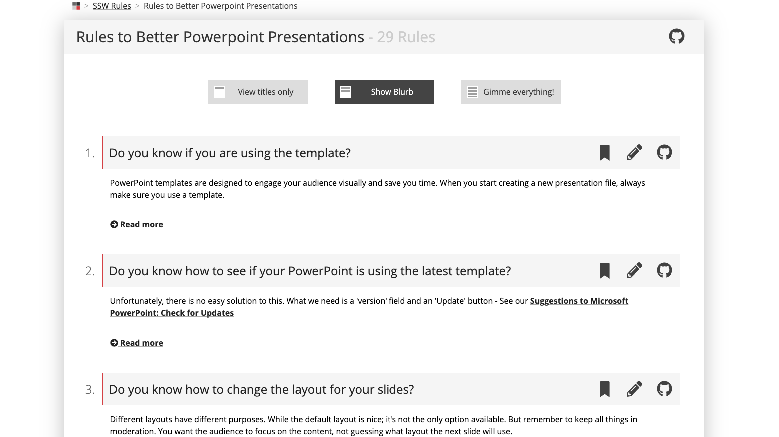
Are you following Rules to Better PPT?
Notes:
https://www.ssw.com.au/rules/rules-to-better-powerpoint-presentations

Slide 22

“Leave audiences with a memorable quote. Think about an important point in your presentation and use it in this layout.”
- Adam Cogan, This Very Slide

Slide 23
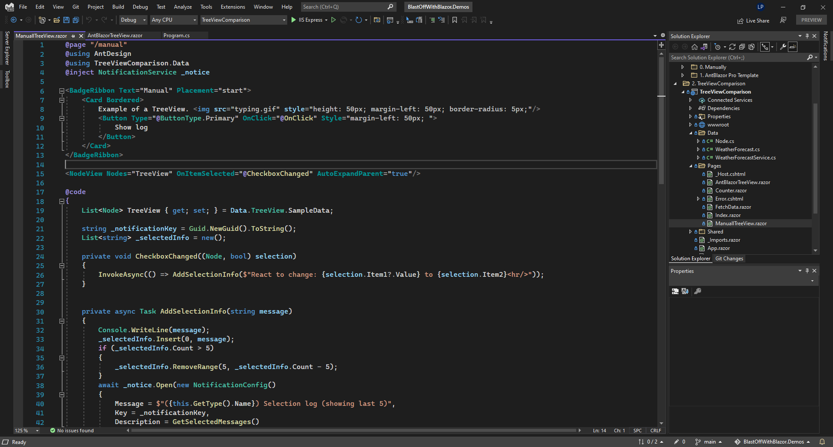
Notes:
Make sure your screenshots are full screen and taken at 125% browser zoom.
https://www.ssw.com.au/rules/do-you-use-the-full-slide-for-screenshots
Use dark mode if you’re cool (keeping with SSW colors).

Slide 24
Indenting Text
If you press tab
While selecting the text
You can indent it
Without adding bullet points

Slide 25
The Pros and Cons of Pie
Pie is delicious
I could eat a lot of pie
I love pie
Add your own animation you lazy buggers
Pie is possibly too delicious
Eating too much pie makes you fat
I also like cheesecake
Notes:
https://www.ssw.com.au/rules/have-good-and-bad-bullet-points

Slide 26
Cake versus Pie
Cake
Sweet
May contain cream
Sometimes contains nuts
Pie
Savoury…. Usually
May contain meat and gravy
Doesn’t usually have nuts

Slide 27
Cake versus Pie versus…
Cake
Sweet
May contain cream
Sometimes contains nuts
Pie
Savoury…. Usually
May contain meat and gravy
Doesn’t usually have nuts
Potato
I love potatoes

Slide 28
This slide has no title, it’s basically made for a huge block of text. You can style this however you want.
With a custom style, the boring slide is now super classy

Slide 29


This is a blank slide
Mainly for drawing shapes or small screenshots
You can do anything you want on this slide

Slide 30
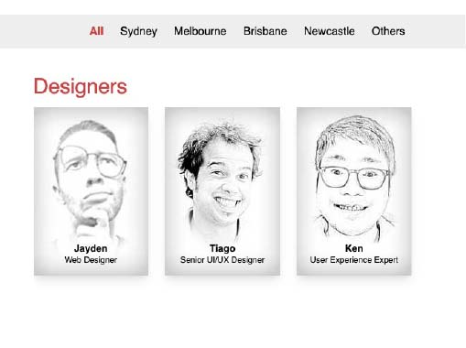
Has a designer done a Test Please on your slides?
This layout is made for a screenshot with some descriptive text. A brave Designer did this so you wouldn’t have to.
Notes:
https://www.ssw.com.au/rules/conduct-a-test-please-internally-and-then-with-the-client

Slide 31

Has a designer done a Test Please on your slides?
This layout is made for a screenshot with some descriptive text. A bave Designer did this so you wouldn’t have to.
Notes:
https://www.ssw.com.au/rules/conduct-a-test-please-internally-and-then-with-the-client

Slide 32
Resources
Vercel Documentation
ssw.com.au/rules/rules-to-better-powerpoint-presentations
Dan’s Blog
ssw.com.au/rules/use-creative-commons-images
Do you use a standard question mark when you are going to ask the audience something
ssw.com.au/rules/do-you-use-standard-question-mark-when-you-are-going-to-ask-the-audience-something
Next.js in 100 Seconds // Plus Full Beginner’s Tutorial
https://www.youtube.com/watch?v=Sklc_fQBmcs
Do you use the full slide for screenshots
ssw.com.au/rules/do-you-use-the-full-slide-for-screenshots
Do you have good and bad bullet points
ssw.com.au/rules/have-good-and-bad-bullet-points
Do you finish your presentation with a thank you slide
ssw.com.au/rules/do-you-finish-your-presentation-with-a-thank-you-slide
Notes:
Tip: Resources indicates that you’re nearing the end of your presentation

Slide 33
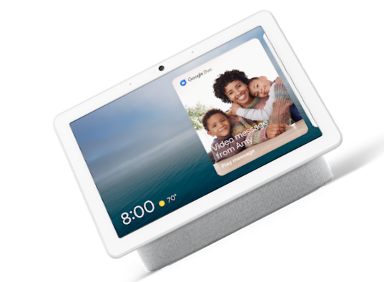
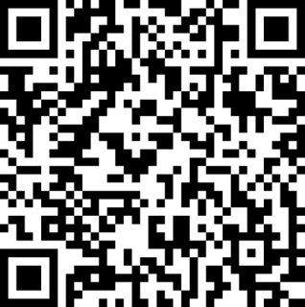


Scan the QR code below and earn
SSW Points for watching this talk!

Slide 34
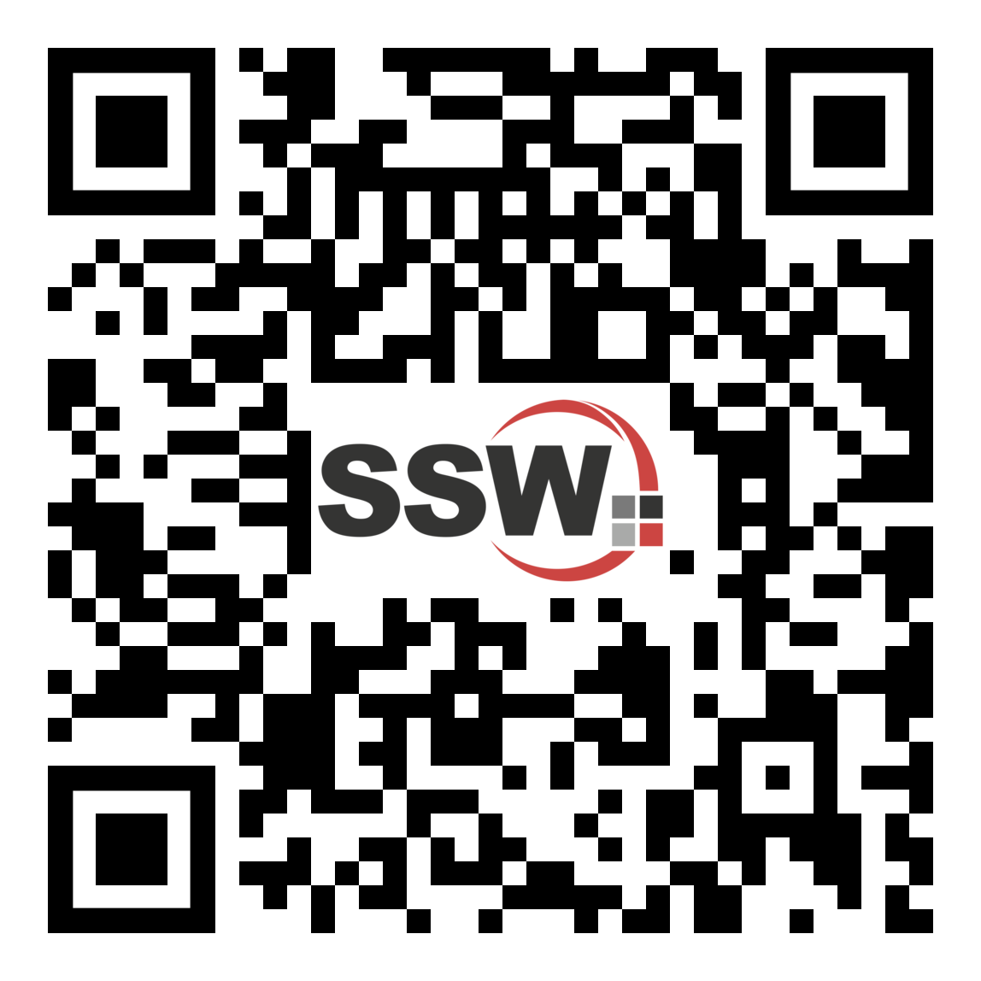
Got feedback?
Scan the QR code here
to fill our survey.
Vercel – Simplifying your Development with Zero Configuration with Tylah Kapa

Slide 35
Summary
Select this shape object
Drawing Tools | Format | Shape Fill
Change to red
Only one of these should be red
Recommended selected color is SSW Red
Delete Extra Segments (Have no more than 6 points)
Notes:
Tip: Just copy your Agenda slide and change one word (From Agenda to Summary)

Slide 36
Find this presentation on GitHub!
github.com/sswconsulting/presentations
Notes:
https://www.ssw.com.au/rules/do-you-keep-your-presentations-in-a-public-location
Example slides: https://github.com/Hona/BlastOffWithBlazor.Demos/raw/main/Presentation.pptx

Slide 37

Thank you! info@ssw.com.au www.ssw.com.au Sydney | Melbourne | Brisbane | Newcastle
Notes:
Note: You should say “thank you” and then pause for 4-5 seconds… to give the audience time to applaud!
https://www.ssw.com.au/rules/do-you-finish-your-presentation-with-a-thank-you-slide

Slide 38
Questions? info@ssw.com.au www.ssw.com.au Sydney | Melbourne | Brisbane | Newcastle
Notes:
Note: You should pause for applause here!
https://www.ssw.com.au/rules/do-you-finish-your-presentation-with-a-thank-you-slide

